Slide 1

计算机组成与系统结构 Computer Organization & System Architecture
Huang Kejie (黄科杰) 百人计划研究员
Office: 玉泉校区老生仪楼304
Email address: huangkejie@zju.edu.cn
HP: 17706443800

Slide 2
Sub-Matrix Multiplication or: Beating Amdahl’s Law
Blocking:
Rearrange code to use values loaded in cache many times
Only “few” accesses to slow main memory (DRAM) per floating point operation
→ throughput limited by FP hardware and cache, not slow DRAM
P&H, RISC-V edition p. 465

Slide 3
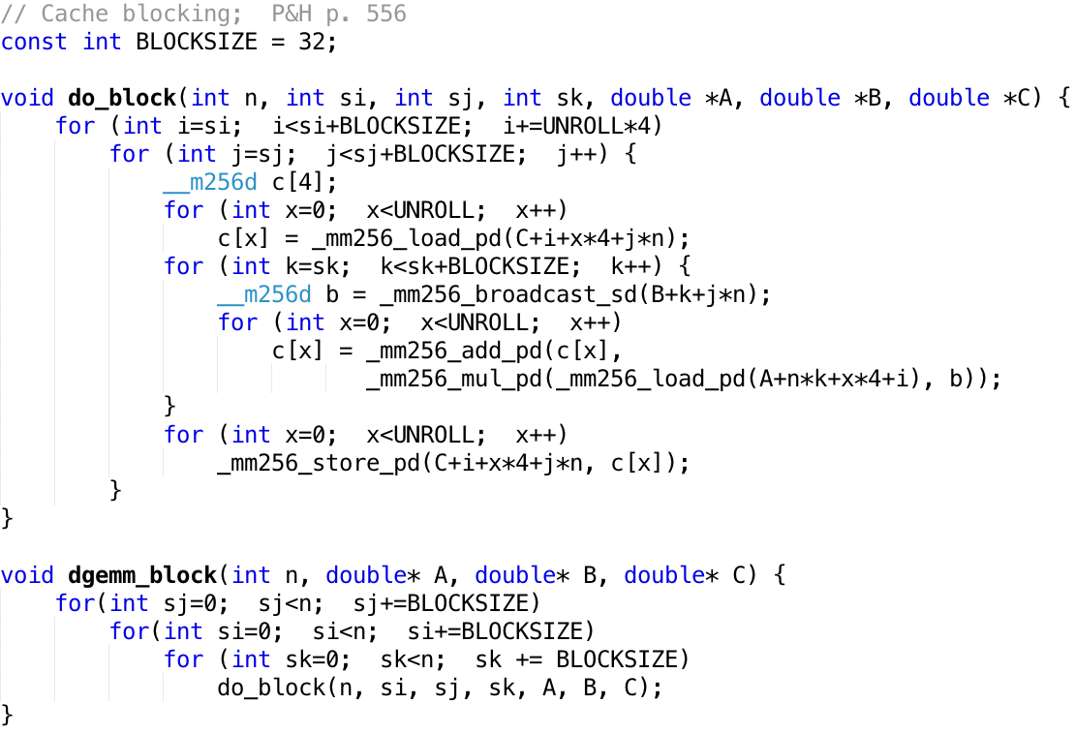
Memory Access Blocking

Slide 4
Performance
N | Gflops
 | scalar | avx | unroll | blocking
32 | 1.30 | 4.56 | 12.95 | 13.80
160 | 1.30 | 5.47 | 19.70 | 21.79
480 | 1.32 | 5.27 | 14.50 | 20.17
960 | 0.91 | 3.64 | 6.91 | 15.82

Slide 5
Improving Performance
Increase clock rate fs
Reached practical maximum for today’s technology
< 5GHz for general purpose computers
Lower CPI (cycles per instruction)
SIMD, “instruction level parallelism”
Perform multiple tasks simultaneously
Multiple CPUs, each executing different program
Tasks may be related
E.g. each CPU performs part of a big matrix multiplication
or unrelated
E.g. distribute different web http requests over different computers
E.g. run pptx (view lecture slides) and browser (youtube) simultaneously
Do all of the above:
High fs, SIMD, multiple parallel tasks
Today’s
lecture

Slide 6


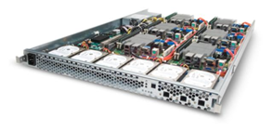
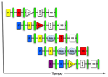
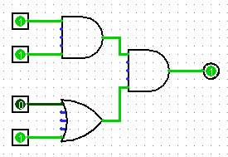
New-School Machine Structures (It’s a bit more complicated!)
Parallel Requests
Assigned to computer
e.g., Search “Katz”
Parallel Threads
Assigned to core
e.g., Lookup, Ads
Parallel Instructions
>1 instruction @ one time
e.g., 5 pipelined instructions
Parallel Data
>1 data item @ one time
e.g., Add of 4 pairs of words
Hardware descriptions
All gates @ one time
Programming Languages
Software Hardware
Warehouse Scale Computer
Smart Phone
Harness Parallelism &
Achieve High Performance
Computer
Core
…
Core
Memory (Cache)
Input/Output
Core
Instruction Unit(s)
Functional
Unit(s)
Today’s
Lecture
A₀+B₀
A₁+B₁
A₂+B₂
A₃+B₃
Cache Memory
Logic Gates

Slide 7
Parallel Computer Architectures
Massive array of computers,
fast communication between processors
Several separate computers,
some means for communication
(e.g., Ethernet)
GPU “graphics processing unit”
Multi-core CPU:
1 datapath in single chip
share L3 cache, memory, peripherals
Example: Hive machines

Slide 8
Example: CPU with Two Cores
Processor “Core” 1
Control
Processor 0 Memory Accesses
Memory
Input
Datapath
PC
Registers
(ALU)
Bytes
Processor “Core” 2
Processor 1 Memory Accesses
Control
Datapath
Output
PC
Registers
(ALU)
I/O-Memory Interfaces

Slide 9
Multiprocessor Execution Model
Each processor (core) executes its own instructions
Separate resources (not shared)
Datapath (PC, registers, ALU)
Highest level caches (e.g., 1st and 2nd)
Shared resources
Memory (DRAM)
Often 3rd level cache
Often on same silicon chip
But not a requirement
Nomenclature
“Multiprocessor Microprocessor”
Multicore processor
E.g., four core CPU (central processing unit)
Executes four different instruction streams simultaneously

Slide 10
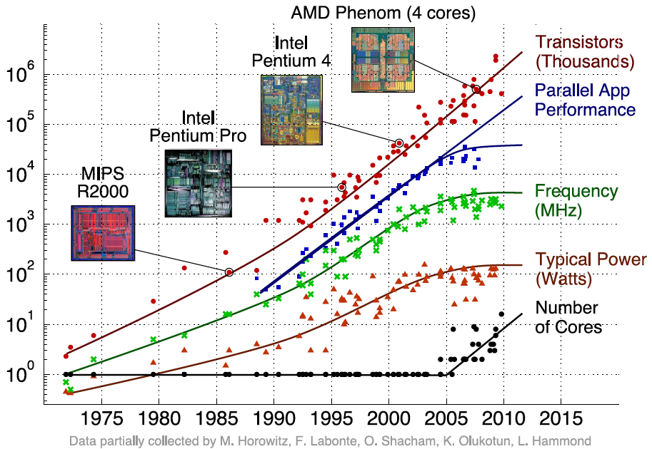
Transition to Multicore
+50% per year, ~ 100x per decade
Sequential App Performance

Slide 11
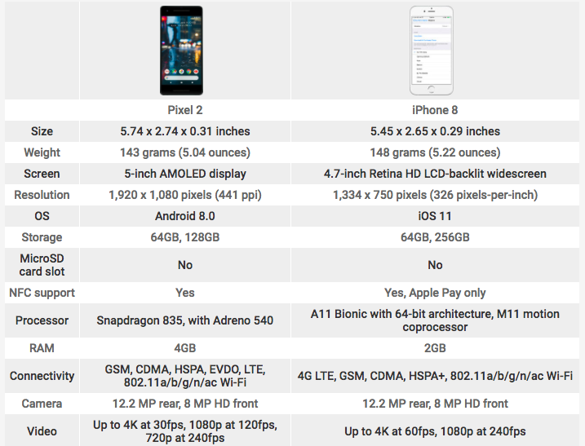
Pixel 2 vs. iPhone 8

Slide 12
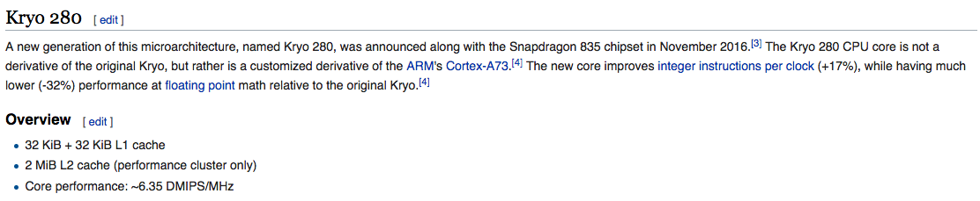
Pixel 2 vs. iPhone 8
2.35Ghz + 1.9Ghz, 64Bit Octa-Core
ALUs
nm
MHz
GFlops

Slide 13
Pixel 2 vs. iPhone 8

Slide 14
Pixel 2 vs. iPhone 8

Slide 15
Multiprocessor Execution Model
Shared memory
Each “core” has access to the entire memory in the processor
Special hardware keeps caches consistent
Advantages:
Simplifies communication in program via shared variables
Drawbacks:
Does not scale well:
“Slow” memory shared by many “customers” (cores)
May become bottleneck (Amdahl’s Law)
Two ways to use a multiprocessor:
Job-level parallelism
Processors work on unrelated problems
No communication between programs
Partition work of single task between several cores
E.g., each performs part of large matrix multiplication

Slide 16
Parallel Processing
It’s difficult!
It’s inevitable
Only path to increase performance
Only path to lower energy consumption (improve battery life)
In mobile systems (e.g., smart phones, tablets)
Multiple cores
Dedicated processors, e.g.,
Motion processor, image processor, neural processor in iPhone 8 + X
GPU (graphics processing unit)
Warehouse-scale computers
Multiple “nodes”
“Boxes” with several CPUs, disks per box
MIMD (multi-core) and SIMD (e.g. AVX) in each node

Slide 17
Potential Parallel Performance (assuming software can use it)
Year | Cores | SIMD bits /Core | Core * SIMD bits | Total, e.g. FLOPs/Cycle
2003 | 2 | 128 | 256 | 4
2005 | 4 | 128 | 512 | 8
2007 | 6 | 128 | 768 | 12
2009 | 8 | 128 | 1024 | 16
2011 | 10 | 256 | 2560 | 40
2013 | 12 | 256 | 3072 | 48
2015 | 14 | 512 | 7168 | 112
2017 | 16 | 512 | 8192 | 128
2019 | 18 | 1024 | 18432 | 288
2021 | 20 | 1024 | 20480 | 320
MIMD
SIMD
MIMD & SIMD
+2/
2yrs
2X/
4yrs
12
years
2.5X
8X
20X
20 x in 12 years
20^{1/12} = 1.28 x → 28% per year or 2x every 3 years!
IF (!) we can use it

Slide 18
Programs Running on my Computer
PID TTY TIME CMD
220 ?? 0:04.34 /usr/libexec/UserEventAgent (Aqua)
222 ?? 0:10.60 /usr/sbin/distnoted agent
224 ?? 0:09.11 /usr/sbin/cfprefsd agent
229 ?? 0:04.71 /usr/sbin/usernoted
230 ?? 0:02.35 /usr/libexec/nsurlsessiond
232 ?? 0:28.68 /System/Library/PrivateFrameworks/CalendarAgent.framework/Executables/CalendarAgent
234 ?? 0:04.36 /System/Library/PrivateFrameworks/GameCenterFoundation.framework/Versions/A/gamed
235 ?? 0:01.90 /System/Library/CoreServices/cloudphotosd.app/Contents/MacOS/cloudphotosd
236 ?? 0:49.72 /usr/libexec/secinitd
239 ?? 0:01.66 /System/Library/PrivateFrameworks/TCC.framework/Resources/tccd
240 ?? 0:12.68 /System/Library/Frameworks/Accounts.framework/Versions/A/Support/accountsd
241 ?? 0:09.56 /usr/libexec/SafariCloudHistoryPushAgent
242 ?? 0:00.27 /System/Library/PrivateFrameworks/CallHistory.framework/Support/CallHistorySyncHelper
243 ?? 0:00.74 /System/Library/CoreServices/mapspushd
244 ?? 0:00.79 /usr/libexec/fmfd
246 ?? 0:00.09 /System/Library/PrivateFrameworks/AskPermission.framework/Versions/A/Resources/askpermissiond
248 ?? 0:01.03 /System/Library/PrivateFrameworks/CloudDocsDaemon.framework/Versions/A/Support/bird
249 ?? 0:02.50 /System/Library/PrivateFrameworks/IDS.framework/identityservicesd.app/Contents/MacOS/identityservicesd
250 ?? 0:04.81 /usr/libexec/secd
254 ?? 0:24.01 /System/Library/PrivateFrameworks/CloudKitDaemon.framework/Support/cloudd
258 ?? 0:04.73 /System/Library/PrivateFrameworks/TelephonyUtilities.framework/callservicesd
267 ?? 0:02.15 /System/Library/CoreServices/AirPlayUIAgent.app/Contents/MacOS/AirPlayUIAgent --launchd
271 ?? 0:03.91 /usr/libexec/nsurlstoraged
274 ?? 0:00.90 /System/Library/PrivateFrameworks/CommerceKit.framework/Versions/A/Resources/storeaccountd
282 ?? 0:00.09 /usr/sbin/pboard
283 ?? 0:00.90 /System/Library/PrivateFrameworks/InternetAccounts.framework/Versions/A/XPCServices/com.apple.internetaccounts.xpc/Contents/MacOS/com.apple.internetaccounts
285 ?? 0:04.72 /System/Library/Frameworks/ApplicationServices.framework/Frameworks/ATS.framework/Support/fontd
291 ?? 0:00.25 /System/Library/Frameworks/Security.framework/Versions/A/Resources/CloudKeychainProxy.bundle/Contents/MacOS/CloudKeychainProxy
292 ?? 0:09.54 /System/Library/CoreServices/CoreServicesUIAgent.app/Contents/MacOS/CoreServicesUIAgent
293 ?? 0:00.29 /System/Library/PrivateFrameworks/CloudPhotoServices.framework/Versions/A/Frameworks/CloudPhotoServicesConfiguration.framework/Versions/A/XPCServices/com.apple.CloudPhotosConfiguration.xpc/Contents/MacOS/com.apple.CloudPhotosConfiguration
297 ?? 0:00.84 /System/Library/PrivateFrameworks/CloudServices.framework/Resources/com.apple.sbd
302 ?? 0:26.11 /System/Library/CoreServices/Dock.app/Contents/MacOS/Dock
303 ?? 0:09.55 /System/Library/CoreServices/SystemUIServer.app/Contents/MacOS/SystemUIServer
… 156 total at this moment
How does my laptop do this?
Imagine doing 156 assignments all at the same time!

Slide 19
Threads
Sequential flow of instructions that performs some task
Up to now we just called this a “program”
Each thread has:
Dedicated PC (program counter)
Separate registers
Accesses the shared memory
Each physical core provides one (or more)
Hardware threads that actively execute instructions
Each executes one “hardware thread”
Operating system multiplexes multiple
Software threads onto the available hardware threads
All threads except those mapped to hardware threads are waiting

Slide 20
Operating System Threads
Give illusion of many “simultaneously” active threads
Multiplex software threads onto hardware threads:
Switch out blocked threads (e.g., cache miss, user input, network access)
Timer (e.g., switch active thread every 1 ms)
Remove a software thread from a hardware thread by
Interrupting its execution
Saving its registers and PC to memory
Start executing a different software thread by
Loading its previously saved registers into a hardware thread’s registers
Jumping to its saved PC

Slide 21
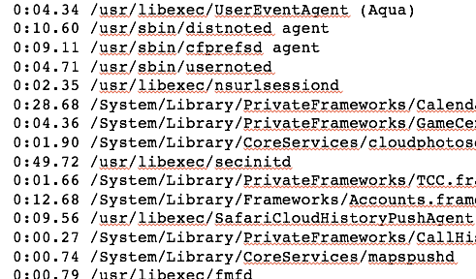
Example: Four Cores
Thread pool:
List of threads competing for processor
OS maps threads to cores and schedules
logical (software) threads
Core 1
Core 2
Core 3
Core 4
Each “Core” actively runs one instruction stream at a time

Slide 22
Multithreading
Typical scenario:
Active thread encounters cache miss
Active thread waits ～ 1000 cycles for data from DRAM
→ switch out and run different thread until data available
Problem
Must save current thread state and load new thread state
PC, all registers (could be many, e.g. AVX)
→ must perform switch in ≪1000 cycles
Can hardware help?
Moore’s Law: transistors are plenty

Slide 23
Types of Parallelism in Applications
Instruction-level parallelism (ILP)
Multiple instructions in execution at the same time, e.g., instruction pipelining
Generated and managed by hardware (superscalar) or by compiler (VLIW)
Limited in practice by data and control dependences, i.e., pipeline hazards
Thread-level or task-level parallelism (TLP)
Multiple threads or instruction sequences from the same application can be executed concurrently
Thread: sequence of instructions, with own program counter and processor state (e.g., register file)
Multicore:
Physical CPU: One thread (at a time) per CPU, in software OS switches threads typically in response to I/O events like disk read/write
Logical CPU: Fine-grain thread switching, in hardware, when thread blocks due to cache miss/memory access
Hyperthreading (aka Simultaneous Multithreading--SMT): Exploit superscalar architecture to launch instructions from different threads at the same time!
Limited in practice by communication/synchronization overheads and by algorithm characteristics

Slide 24
Types of Parallelism in Applications
Data-level parallelism (DLP)
Instructions from a single stream operate concurrently on several data
Limited by non-regular data manipulation patterns and by memory bandwidth
Transaction-level parallelism
Multiple threads/processes from different transactions can be executed concurrently
Limited by concurrency overheads

Slide 25
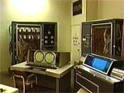
CDC 6600 Peripheral Processors (Cray, 1964)
First multithreaded hardware
10 “virtual” I/O processors
Fixed interleave on simple pipeline
Pipeline has 100ns cycle time
Each virtual processor executes one instruction every 1000ns
Accumulator-based instruction set to reduce processor state

Slide 26
Simple Multithreaded Pipeline
X
PC
1
GPR1
PC
1
I$
IR
GPR1
PC
1
GPR1
PC
1
GPR1
D$
Y
+1
2
Thread select
2
Have to carry thread select down pipeline to ensure correct state bits read/written at each pipe stage
Appears to software (including OS) as multiple, albeit slower, CPUs

Slide 27
Multithreading Costs
Each thread requires its own user state
PC
GPRs
Also, needs its own system state
Virtual-memory page-table-base register
Exception-handling registers
Other overheads:
Additional cache/TLB conflicts from competing threads
(or add larger cache/TLB capacity)
More OS overhead to schedule more threads (where do all these threads come from?)

Slide 28
Thread Scheduling Policies
Fixed interleave (CDC 6600 PPUs, 1964)
Each of N threads executes one instruction every N cycles
If thread not ready to go in its slot, insert pipeline bubble
Software-controlled interleave (TI ASC PPUs, 1971)
OS allocates S pipeline slots amongst N threads
Hardware performs fixed interleave over S slots, executing whichever thread is in that slot
Hardware-controlled thread scheduling (HEP, 1982)
Hardware keeps track of which threads are ready to go
Picks next thread to execute based on hardware priority scheme

Slide 29
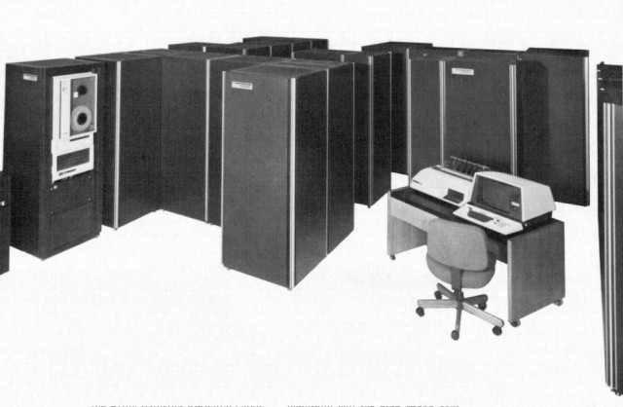
Denelcor HEP (Burton Smith, 1982)
First commercial machine to use hardware threading in main CPU
120 threads per processor
10 MHz clock rate
Up to 8 processors
precursor to Tera MTA (Multithreaded Architecture)

Slide 30
Simultaneous Multithreading (SMT) for OoO Superscalars
Techniques presented so far have all been “vertical” multithreading where each pipeline stage works on one thread at a time
SMT uses fine-grain control already present inside an OoO superscalar to allow instructions from multiple threads to enter execution on same clock cycle. Gives better utilization of machine resources.

Slide 31
Superscalar Machine Efficiency
Issue width
Instruction issue
Completely idle cycle (vertical waste)
Time
Partially filled cycle, i.e., IPC < 4
(horizontal waste)

Slide 32
Vertical Multithreading
Issue width
Instruction issue
Second thread interleaved cycle-by-cycle
Time
Partially filled cycle, i.e., IPC < 4
(horizontal waste)
Cycle-by-cycle interleaving removes vertical waste, but leaves some horizontal waste

Slide 33
Chip Multiprocessing (CMP)
Issue width
Time
What is the effect of splitting into multiple processors?
reduces horizontal waste,
leaves some vertical waste, and
puts upper limit on peak throughput of each thread.

Slide 34
Ideal Superscalar Multithreading [Tullsen, Eggers, Levy, UW, 1995]
Issue width
Time
Interleave multiple threads to multiple issue slots with no restrictions

Slide 35
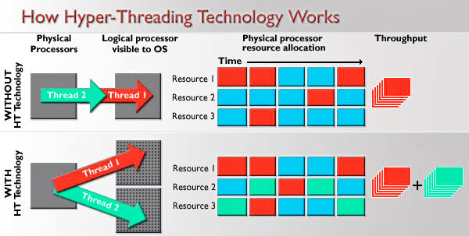
Hyperthreading
SMT (HT): Logical CPUs > Physical CPUs
Run multiple threads at the same time per core
Each thread has own architectural state (PC, Registers, etc.)
Share resources (cache, instruction unit, execution units)
Improves Core CPI (clock ticks per instruction)
May degrade Thread CPI (Utilization/Bandwidth v. Latency)
See http://dada.cs.washington.edu/smt/

Slide 36
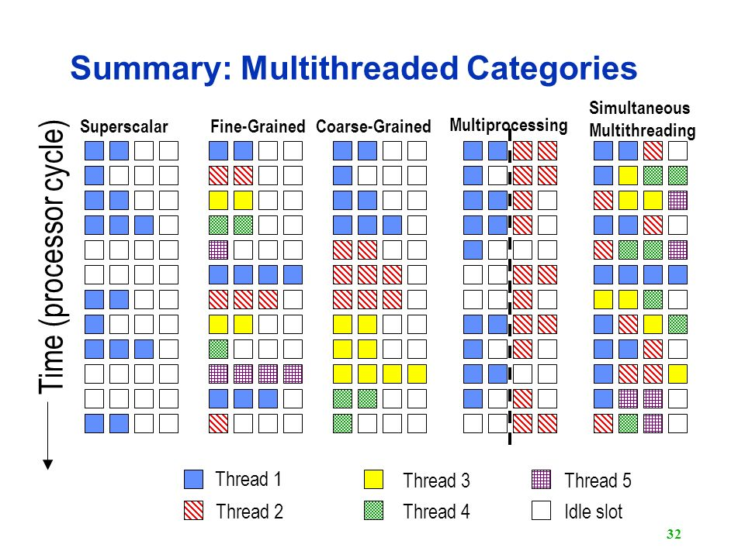
Multithreaded Categories

Slide 37
Initial Performance of SMT
Pentium-4 Extreme SMT yields 1.01 speedup for SPECint_rate benchmark and 1.07 for SPECfp_rate
Pentium-4 is dual-threaded SMT
SPECRate requires that each SPEC benchmark be run against a vendor-selected number of copies of the same benchmark
Running on Pentium-4 each of 26 SPEC benchmarks paired with every other (262 runs) speed-ups from 0.90 to 1.58; average was 1.20
Power 5, 8-processor server 1.23 faster for SPECint_rate with SMT, 1.16 faster for SPECfp_rate
Power 5 running 2 copies of each app speedup between 0.89 and 1.41
Most gained some
Fl.Pt. apps had most cache conflicts and least gains

Slide 38
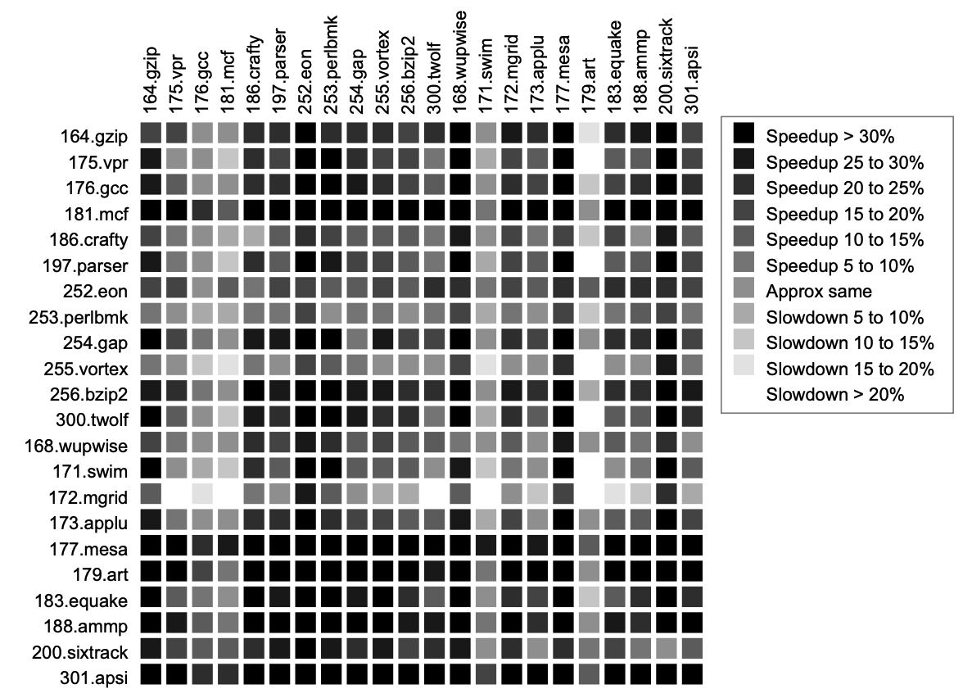
SMT Performance: Application Interaction
Not affected by other programs
Bulpin et al, “Multiprogramming Performance of Pentium 4 with Hyper-Threading”

Slide 39
SMT Performance: Application Interaction
Doesn’t play nice
Bulpin et al, “Multiprogramming Performance of Pentium 4 with Hyper-Threading”

Slide 40
SMT Performance: Application Interaction
Very sensitive to second program
Bulpin et al, “Multiprogramming Performance of Pentium 4 with Hyper-Threading”

Slide 41
Hardware Assisted Software Multithreading
Processor (1 Core, 2 Threads)
Control
Memory
Input
Datapath
PC 0
PC 1
Registers 0
Registers 1
(ALU)
Bytes
Two copies of PC and Registers inside processor hardware
Looks identical to two processors to software (hardware thread 0, hardware thread 1)
Hyperthreading:
Both threads can be active simultaneously
Output
I/O-Memory Interfaces

Slide 42
Multithreading
Logical threads
≈ 1% more hardware, ≈ 10% (?) better performance
Separate registers
Share datapath, ALU(s), caches
Multicore
=> Duplicate Processors
≈50% more hardware, ≈2X better performance?
Modern machines do both
Multiple cores with multiple threads per core

Slide 43
Randy’s (Rather Old) Mac Air
$ sysctl -a | grep hw
hw.model = Core i7, 4650U
…
hw.physicalcpu: 2
hw.logicalcpu: 4
…
hw.cpufrequency = 1,700,000,000
hw.physmem = 8,589,934,592 (8 Gbytes) ...
hw.cachelinesize = 64
hw.l1icachesize: 32,768
hw.l1dcachesize: 32,768
hw.l2cachesize: 262,144
hw.l3cachesize: 4,194,304
Every machine is multicore,
Even your phone!

Slide 44
Hive Machines
hw.model = Core i7 4770K
hw.physicalcpu: 4
hw.logicalcpu: 8
…
hw.cpufrequency = 3,900,000,000
hw.physmem = 34,359,738,368
hw.cachelinesize = 64
hw.l1icachesize: 32,768
hw.l1dcachesize: 32,768
hw.l2cachesize: 262,144
hw.l3cachesize: 8,388,608
Therefore, should try up to 8 threads to see if performance gain even though only 4 cores

Slide 45
Example: 6 Cores, 24 Logical Threads
Thread pool:
List of threads competing for processor
OS maps threads to cores and schedules
logical (software) threads
Core 1
Core 2
Core 3
Core 4
Core 5
Core 6
Thread 1
Thread 1
Thread 1
Thread 1
Thread 1
Thread 1
Thread 2
Thread 2
Thread 2
Thread 2
Thread 2
Thread 2
Thread 3
Thread 3
Thread 3
Thread 3
Thread 3
Thread 3
Thread 4
Thread 4
Thread 4
Thread 4
Thread 4
Thread 4
4 Logical threads per core (hardware) thread

Slide 46
Languages Supporting Parallel Programming
ActorScript | Concurrent Pascal | JoCaml | Orc
Ada | Concurrent ML | Join | Oz
Afnix | Concurrent Haskell | Java | Pict
Alef | Curry | Joule | Reia
Alice | CUDA | Joyce | SALSA
APL | E | LabVIEW | Scala
Axum | Eiffel | Limbo | SISAL
Chapel | Erlang | Linda | SR
Cilk | Fortan 90 | MultiLisp | Stackless Python
Clean | Go | Modula-3 | SuperPascal
Clojure | Io | Occam | VHDL
Concurrent C | Janus | occam-π | XC
Which one to pick?

Slide 47
Why So Many Parallel Programming Languages?
Why “intrinsics”?
TO Intel: fix your #()&$! Compiler!
It’s happening ... but
SIMD features are continually added to compilers (Intel, gcc)
Intense area of research
Research progress:
20+ years to translate C into good (fast!) assembly
How long to translate C into good (fast!) parallel code?
General problem is very hard to solve
Present state: specialized solutions for specific cases
Your opportunity to become famous!

Slide 48
Review: Why Parallelism?
Only path to performance is parallelism
Clock rates flat or declining
SIMD: 2X width every 3-4 years
AVX-512 2015, 1024b in 2018? 2019?
MIMD: Add 2 cores every 2 years (2, 4, 6, 8, 10, …) Intel Broadwell-Extreme (2Q16): 10 Physical CPUs, 20 Logical CPUs
Key challenge: craft parallel programs with high performance on multiprocessors as # of processors increase – i.e., that scale
Scheduling, load balancing, time for synchronization, overhead for communication

Slide 49
Parallel Programming Languages
Number of choices is indication of
No universal solution
Needs are very problem specific
E.g.,
Scientific computing/machine learning (matrix multiply)
Webserver: handle many unrelated requests simultaneously
Input / output: it’s all happening simultaneously!
Specialized languages for different tasks
Some are easier to use (for some problems)
None is particularly ”easy” to use

Slide 50
Parallel Loops
Serial execution:
for (int i=0; i<100; i++) {
…
}
Parallel Execution:
for (int i=0; i<25; i++) { … } | for (int i=25; i<50; i++) { … } | for (int i=50; i<75; i++) { … } | for (int i=75; i<100; i++) { … }

Slide 51
OpenMP Building Block: for loop
for (i=0; i<max; i++) zero[i] = 0;
Breaks for loop into chunks, and allocate each to a separate thread
e.g. if max = 100 with 2 threads: assign 0-49 to thread 0, and 50-99 to thread 1
Must have relatively simple “shape” for an OpenMP-aware compiler to be able to parallelize it
Necessary for the run-time system to be able to determine how many of the loop iterations to assign to each thread
No premature exits from the loop allowed
i.e. No break, return, exit, goto statements
In general, don’t jump outside of any pragma block

Slide 52
Parallel for in OpenMP
#include <omp.h>
#pragma omp parallel for
for (int i=0; i<100; i++) {
…
}

Slide 53
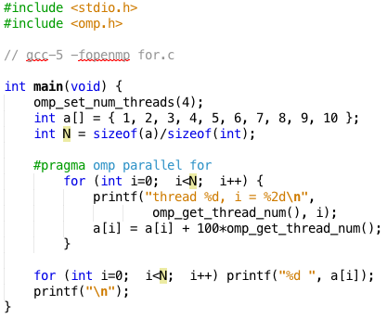
OpenMP Example
$ gcc-5 -fopenmp for.c;./a.out
thread 0, i = 0
thread 1, i = 3
thread 2, i = 6
thread 3, i = 8
thread 0, i = 1
thread 1, i = 4
thread 2, i = 7
thread 3, i = 9
thread 0, i = 2
thread 1, i = 5
01 02 03 14 15 16 27 28 39 40

Slide 54
OpenMP
C extension: no new language to learn
Multi-threaded, shared-memory parallelism
Compiler Directives, #pragma
Runtime Library Routines, #include <omp.h>
#pragma
Ignored by compilers unaware of OpenMP
Same source for multiple architectures
E.g., same program for 1 & 16 cores
Only works with shared memory

Slide 55
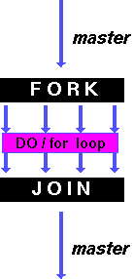
OpenMP Parallel for pragma
#pragma omp parallel for
for (i=0; i<max; i++) zero[i] = 0;
Master thread creates additional threads, each with a separate execution context
All variables declared outside for loop are shared by default, except for loop index which is implicitly private per thread
Implicit “barrier” synchronization at end of for loop
Divide index regions sequentially per thread
Thread 0 gets 0, 1, …, (max/n)-1;
Thread 1 gets max/n, max/n+1, …, 2*(max/n)-1
Why?

Slide 56
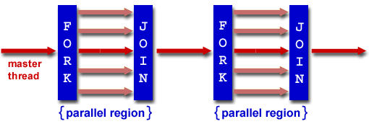
OpenMP Programming Model
Fork - Join Model:
OpenMP programs begin as single process (master thread)
Sequential execution
When parallel region is encountered
Master thread “forks” into team of parallel threads
Executed simultaneously
At end of parallel region, parallel threads ”join”, leaving only master thread
Process repeats for each parallel region
Amdahl’s Law?

Slide 57
What Kind of Threads?
OpenMP threads are operating system (software) threads
OS will multiplex requested OpenMP threads onto available hardware threads
Hopefully each gets a real hardware thread to run on, so no OS-level time-multiplexing
But other tasks on machine compete for hardware threads!

